Slide 1
Mesopotamia
SSWH1 Analyze the origins, structures, and interactions of societies in the ancient world from 3500 BCE/BC to 500 BCE/BC.
a. Compare and contrast Mesopotamian and Egyptian societies, include: religion, culture, economics, politics, and technology.

Slide 2
River Valley Civilizations
3300-1900 BC Sumer (Mesopotamia)
2600-1900 BC Indus Valley (Indus River)
2575-2130 BC Egypt (Nile River)
1766-1122 BC Shang China (Huang River “Yellow River”)

Slide 3
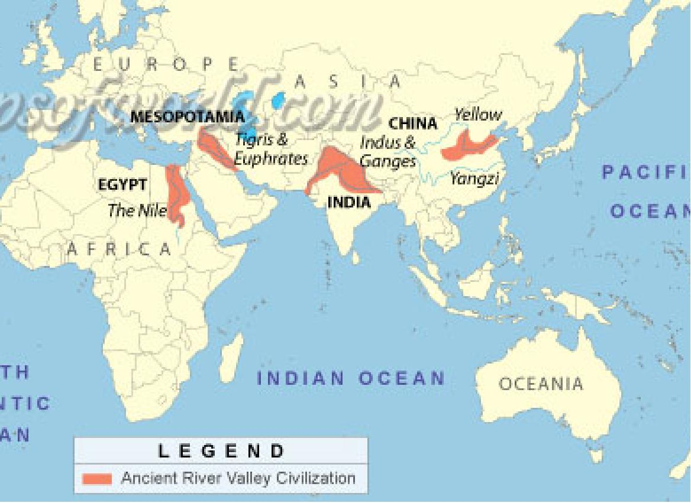

Slide 4
Features that Define a Civilization
Well-organized governments
Complex Religions
Job Specialization
Social classes
Arts & Architecture
Public Works
Writing

Slide 5
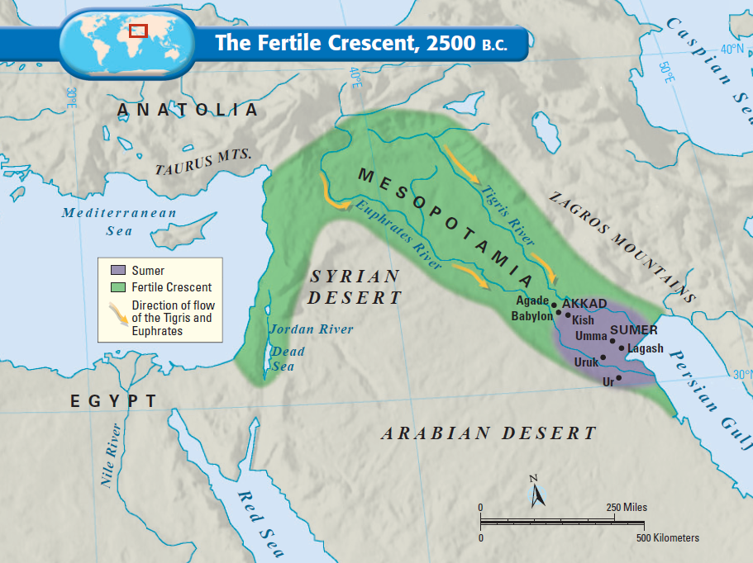
SSWH1 Analyze the origins, structures, and interactions of societies in the ancient world from 3500 BCE/BC to 500 BCE/BC.
a. Compare and contrast Mesopotamian and Egyptian societies, include: religion, culture, economics, politics, and technology.
Mesopotamia means “land between the rivers” & is often called the “Fertile Crescent” or as the “Cradle of Civilization”
The Tigris and Euphrates Rivers flooded once per year, leaving behind fertile soil ideal for farming

Slide 6
SSWH1 Analyze the origins, structures, and interactions of societies in the ancient world from 3500 BCE/BC to 500 BCE/BC.
a. Compare and contrast Mesopotamian and Egyptian societies, include: religion, culture, economics, politics, and technology.
The first civilization developed in the Fertile Crescent: Sumer
But, surrounding deserts & the lack of natural barriers attracted outsiders to Mesopotamia made the Sumerians vulnerable to attack

Slide 7
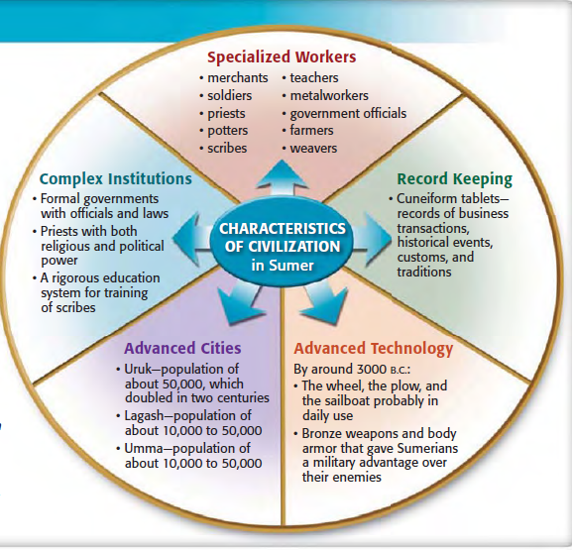

Slide 8
Sumerians
The first to develop and urban civilization in Mesopotamia (modern-day Iraq)
Colonized the marshlands of the lower Euphrates, which together with the Tigris flows into the Persian Gulf
Transformed swamps into fields of barley and groves of date palms
SSWH1 Analyze the origins, structures, and interactions of societies in the ancient world from 3500 BCE/BC to 500 BCE/BC.
a. Compare and contrast Mesopotamian and Egyptian societies, include: religion, culture, economics, politics, and technology.

Slide 9
Sumerians
Approximately 3000BCE their hut settlements gradually evolved into twelve independent city-states (city and its surround countryside)
Each city-state had a walled urban area made up of simple mud-brick dwellings and a ceremonial and administrative center dominated by a Ziggurat.
Populations: tens of thousands
SSWH1 Analyze the origins, structures, and interactions of societies in the ancient world from 3500 BCE/BC to 500 BCE/BC.
a. Compare and contrast Mesopotamian and Egyptian societies, include: religion, culture, economics, politics, and technology.

Slide 10
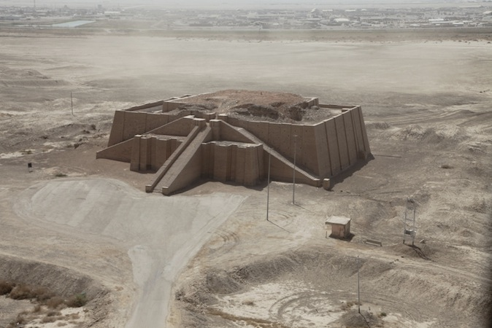
Ziggurat
SSWH1 Analyze the origins, structures, and interactions of societies in the ancient world from 3500 BCE/BC to 500 BCE/BC.
a. Compare and contrast Mesopotamian and Egyptian societies, include: religion, culture, economics, politics, and technology.

Slide 11
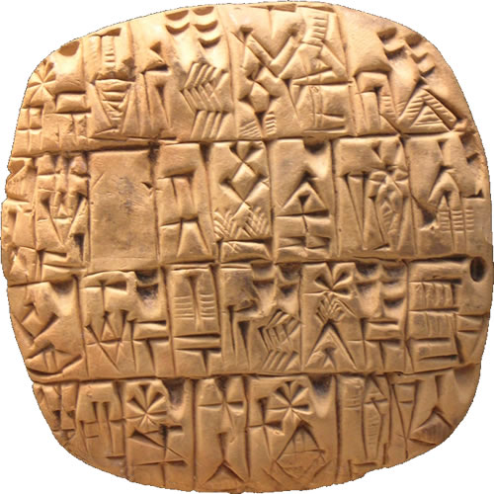
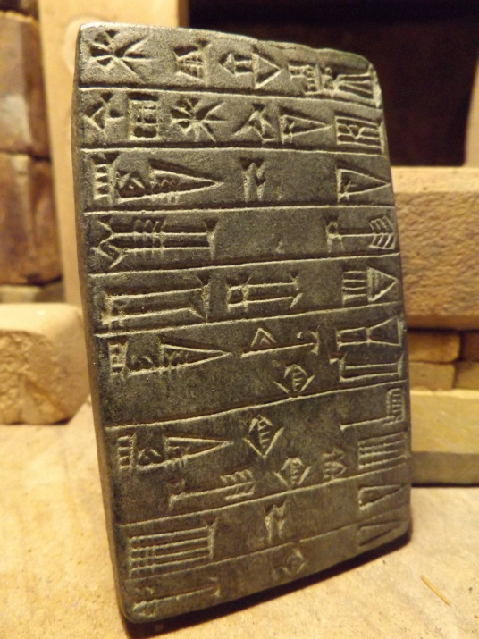
Achievements
SSWH1 Analyze the origins, structures, and interactions of societies in the ancient world from 3500 BCE/BC to 500 BCE/BC.
a. Compare and contrast Mesopotamian and Egyptian societies, include: religion, culture, economics, politics, and technology.
Developed symbol writing (cuneiform)
Pictograms and signs for the numbers were engraved with a reed stylus on clay tablets
Developed
Elaborate brick houses
Palaces and temples
Bronze tools and weapons
Irrigation works
Trade with other peoples
An early form of money
Religious and political institutions
Schools
Religious and secular literature
Art
Codes of law
Medicinal drugs
Lunar Calendar

Slide 12
Warfare
City-states engaged in frequent warfare with each other, over boundaries and water rights--canals built upriver reduced the water available to the cities downriver
Rulers of city-states were responsible for leading armies and enforcing laws
Also responsible for maintaining city walls and irrigations systems
SSWH1 Analyze the origins, structures, and interactions of societies in the ancient world from 3500 BCE/BC to 500 BCE/BC.
a. Compare and contrast Mesopotamian and Egyptian societies, include: religion, culture, economics, politics, and technology.

Slide 13
Legacy
Developed basic algebra and geometry, astronomy
Number system based on 6
Divided hour into 60 minutes
Divided circle into 360 degrees
Built earliest known wheeled carts & wagons (~3000 BC)
Potter’s wheel to make bowls
Looms to weave cloth
Bronze to make tools and weapons
Engineering: irrigation systems and flood control
Invented the Lyre: a string instrument

Slide 14
Akkad
North of the Sumer
Semitic people (name given because of languages spoken)
Assyrian
Akkadian
Babylonian
Phoenician
Arabic
Hebrew
SSWH1 Analyze the origins, structures, and interactions of societies in the ancient world from 3500 BCE/BC to 500 BCE/BC.
a. Compare and contrast Mesopotamian and Egyptian societies, include: religion, culture, economics, politics, and technology.

Slide 15
Akkad
2350 BCE led by Sargon the Great, the warrior King, conquered the Sumerian cites
Sargon built the worlds first empire from the Persian Gulf to the Mediterranean Sea
Mediterranean became a blend of Sumerian and Akkadian elements (Cultural Diffusion)
Despite economic growth and prosperity Sargon’s successors could not preserve his empire. It fell in 2100BC
The spread of ideas, customs, and technologies from one people to and other. Often occurred through migration, trade, and warfare.
SSWH1 Analyze the origins, structures, and interactions of societies in the ancient world from 3500 BCE/BC to 500 BCE/BC.
a. Compare and contrast Mesopotamian and Egyptian societies, include: religion, culture, economics, politics, and technology.

